Slide 1





Applying Logistics Regression model determining the effect of age of a customer on churning
Submitted by : Anirban Chakraborty
Date: 02/07/2020
Professor: Dr. Orenthio Goodwin
Colorado State University Global Campus

Slide 2
Content
Speaker Note
Abstract
Introduction
Research Hypothesis Requirement
Hypothesis
Methodology
Method
Conclusion
Recommendation
Reference

Slide 3
Abstract
Telecomm industry went through lots of ups and downs since Graham Bell first invented telephone in 1876. By 1904 all most three million subscriber got connected through mechanical switch board. By 1914, the U.S. became the world leader in telecom industry and it was having more than twice the telecom industry of Sweden, New Zealand, Switzerland, and Norway. (Tehnofunc Blog,2019)
In this paper , I will use regression analysis to identify which could be cause for churning a customer. This data file on which I will be working in this paper , contains telecommunications company’s effort to reduce churn in its customer base.
Notes:
In this paper , we will use regression analysis to identify which could be cause for churning a customer. This data file on which I will be working in this paper , contains telecommunications company’s effort to reduce churn in its customer base.
In this paper mainly, we are concerned about nine variables namely age, year resides in the current address, income, education, churn, region, gender, marital status and customer category. These variables are mixed of continuous, discrete and categorical which have been discussed in detail in this paper. Treatment for continuous variable is somewhat different than categorical and discrete variable.
For all variables, graphs are created (mainly histogram for continuous variable and bar graphs for categorical variables) and statistical properties like mean, standard deviation and frequency analysis have been computed.
We have done the multiple regression analysis to fit the data into the model and validate and predicted it for continuous variable. But categorical variable, instead of multiple regression, we have done logistic regression analysis to validate the model and for prediction. We have done the hypothesis test for both the cases. SAS is used as primary software to do the all statistical analysis for this paper.

Slide 4
Introduction
This paper is basically to apply regression analysis to handle some real-life scenario using real life data. As I stated in my earlier slides, this data file contains telecommunications company’s effort to reduce churn in its customer base. To do that, there are multiple attributes of a customer have been addressed and taken a sample of 1000 customer to analyze the data
In this paper mainly, we are concerned about nine variables namely age, year resides in the current address, income, education, churn, region, gender, marital status and customer category. These variables are mixed of continuous, discrete and categorical which have been discussed in detail in this paper.
I need to find out how the age is affecting on the churning of a telecom customer. For that I need to come up with null hypothesis and alternate hypothesis

Slide 5
Introduction
Here , since age is categorical variable, instead of multiple regression, we will do logistic regression analysis to validate the model and for prediction. We have done the hypothesis test for both the cases. SAS is used as primary software to do the all statistical analysis for this paper

Slide 6
Data Study
The name of the excel sheet is Telco Extra CSUGlobal.xls which can be accessed from https://csuglobal.instructure.com/courses/7383/assignments/139611?module_item_id=349719
Continuous: Age, Years at current address, Income;
Categorical with 2 categories/Dummy variables: marital status (0=unmarried;1=married), gender (0=male; 1=female), churn (0=not going to churn; 1=going to churn);
Categorical with more than 2 categories: Region (1=Zone 1, 2=Zone 2, 3=Zone 3, 4=Zone 4, 5=Zone 5), Ed (1=did not complete high school, 2=high school degree, 3=some college, 4=college degree, 5=post-undergraduate degree), Custcat (1=basic service, 2=E-service, 3=Plus service, 4=Total service).
Notes:
As I stated above the this data sets contain s telecom data which has all together 34 variables. But in my analysis , I will be using total 9 variables.
In any data dictionary , we generally mention the name of the data item , data type ,max length of the the variable and small description of the data item. In my analysis , data length is not a very important information. But one of the of the important information is category . In my data dictionary I will mention this.

Slide 7
Research Hypothesis Requirement
In this paer we are dealing with nine variables namely age, year resides in the current address, income, education, churn, region, gender, marital status and customer category. Among all those variables ,I am interested to find out how the age is affecting on the churning of a telecom customer. For that I need to come up with null hypothesis and alternate hypothesis

Slide 8

Research Hypothesis
Null Hypothesis: In determination of the churning process , we can use age of a customer as deterministic variable.
Alternate Hypothesis: In determination of the churning process ,we cannot use age as deterministic variable.
Notes:
Once you find your sources, you will want to evaluate your sources using the following questions:
Author:
Who is the author?
Why should I believe what he or she has to say on the topic?
Is the author seen as an expert on the topic? How do you know?
Current:
How current is the information in the source?
When was the source published?
Is the information out-of-date?
Accuracy:
Is the content accurate?
Is the information presented objectively? Do they share the pros and cons?

Slide 9
Methodology
Here we use the logistic regression to seek the answer
A logistic regression model has been built to predict the odds corresponding to an event that has two outcomes. That's why the logistic regression model works with one dependent variable that is a dummy variable (remember that the outcomes of such a variable are 0 and 1) and one or more independent variables (predictors).
Notes:
Now, that you have narrowed your topic, you will want to organize your research in a structure that works. There are some common organizational patterns based on the kind of research you are doing.
Organizational Structures:
Cause and Effect- this kind of structure is great for explaining the causes and effects of a topic
Compare and Contrast- in this pattern you highlight the similarities and differences of the topic
Explain process- this structure is great for outlining a series of steps to follow;
Definition- if you want to make sure your audience understands what something is using illustrations, meanings, clarifying misconceptions, you may want to use this structure
Classification- a common organizational structure is grouping like topics or facts from the research together. For instance, in the internet safety about social media apps, you may organize the research where you look at each social media app one at a time

Slide 10
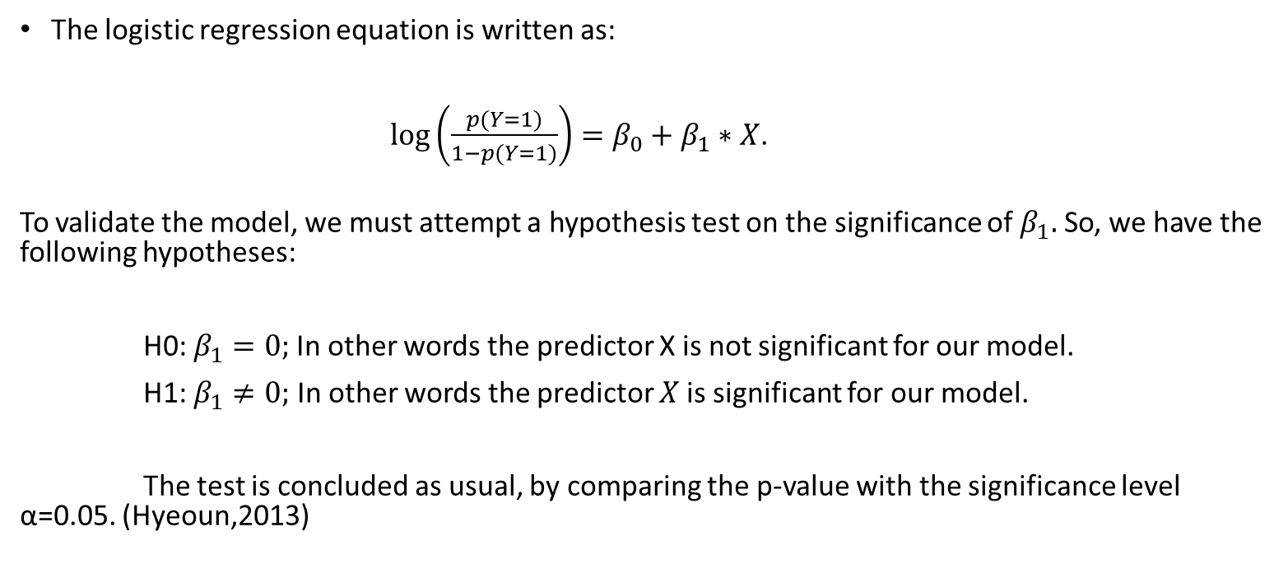
Methodology
The logistic regression equation is written as:
$\log\left(\frac{p(Y=1)}{1−p(Y=1)}\right)=β_{0}+β_{1}∗X$.
To validate the model, we must attempt a hypothesis test on the significance of $β_{1}.$ So, we have the following hypotheses:
H0: $β_{1}=0;$In other words the predictor X is not significant for our model.
H1: $β_{1}≠0;$ In other words the predictor $X$is significant for our model.
The test is concluded as usual, by comparing the p-value with the significance level α=0.05. (Hyeoun,2013)
Notes:
Now, that you have narrowed your topic, you will want to organize your research in a structure that works. There are some common organizational patterns based on the kind of research you are doing.
Organizational Structures:
Cause and Effect- this kind of structure is great for explaining the causes and effects of a topic
Compare and Contrast- in this pattern you highlight the similarities and differences of the topic
Explain process- this structure is great for outlining a series of steps to follow;
Definition- if you want to make sure your audience understands what something is using illustrations, meanings, clarifying misconceptions, you may want to use this structure
Classification- a common organizational structure is grouping like topics or facts from the research together. For instance, in the internet safety about social media apps, you may organize the research where you look at each social media app one at a time

Slide 11
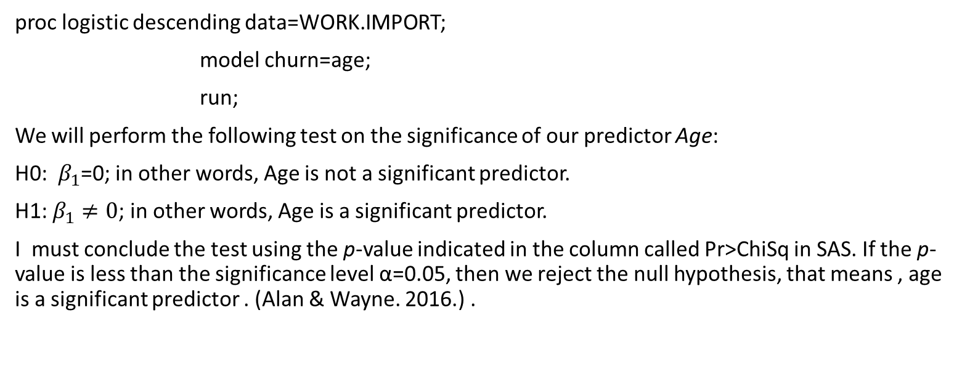
Method (SAS Code)
proc logistic descending data=WORK.IMPORT;
model churn=age;
run;
We will perform the following test on the significance of our predictor Age:
H0: $β_{1}$=0; in other words, Age is not a significant predictor.
H1: $β_{1}≠0$; in other words, Age is a significant predictor.
I must conclude the test using the p-value indicated in the column called Pr>ChiSq in SAS. If the p-value is less than the significance level α=0.05, then we reject the null hypothesis, that means , age is a significant predictor . (Alan & Wayne. 2016.) .
Notes:
Now, that you have narrowed your topic, you will want to organize your research in a structure that works. There are some common organizational patterns based on the kind of research you are doing.
Organizational Structures:
Cause and Effect- this kind of structure is great for explaining the causes and effects of a topic
Compare and Contrast- in this pattern you highlight the similarities and differences of the topic
Explain process- this structure is great for outlining a series of steps to follow;
Definition- if you want to make sure your audience understands what something is using illustrations, meanings, clarifying misconceptions, you may want to use this structure
Classification- a common organizational structure is grouping like topics or facts from the research together. For instance, in the internet safety about social media apps, you may organize the research where you look at each social media app one at a time

Slide 12
Method (SAS Code Output)
Here p value (Pr>ChiSq) value is <.0001 which is less than significant level of 0.05. As we know ,if p value is less than significant level α=0.05 , we can reject the null hypothesis. . (Alan & Wayne. 2016.) .
Analysis of Maximum Likelihood Estimates
Parameter | DF | Estimate | Standard Error | Wald Chi-Square | Pr > ChiSq
Intercept | 1 | 1.0424 | 0.2599 | 16.0912 | <.0001
age | 1 | -0.0505 | 0.00652 | 60.0945 | <.0001

Slide 13
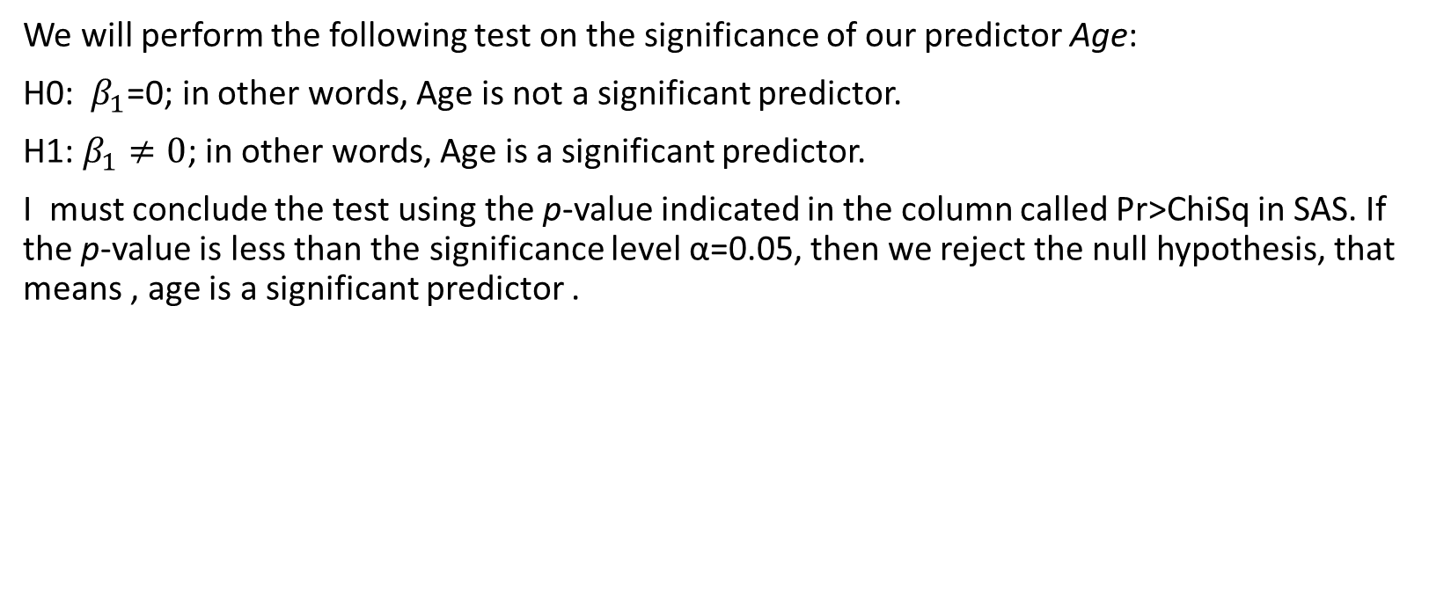
Conclusion
We will perform the following test on the significance of our predictor Age:
H0: $β_{1}$=0; in other words, Age is not a significant predictor.
H1: $β_{1}≠0$; in other words, Age is a significant predictor.
I must conclude the test using the p-value indicated in the column called Pr>ChiSq in SAS. If the p-value is less than the significance level α=0.05, then we reject the null hypothesis, that means , age is a significant predictor .
Notes:
I am concluding the fact that age is a significant predictor.

Slide 14
Conclusion
Hypothesis on hand:
Null Hypothesis: In determination of the churning process , we can use age as deterministic variable.
Alternate Hypothesis: In determination of the churning process ,we cannot use age as deterministic variable.
Since Age is the significant predictor, we can not reject null hypothesis here. We can tell that “In determination of the churning process , we can use age as deterministic variable.”

Slide 15
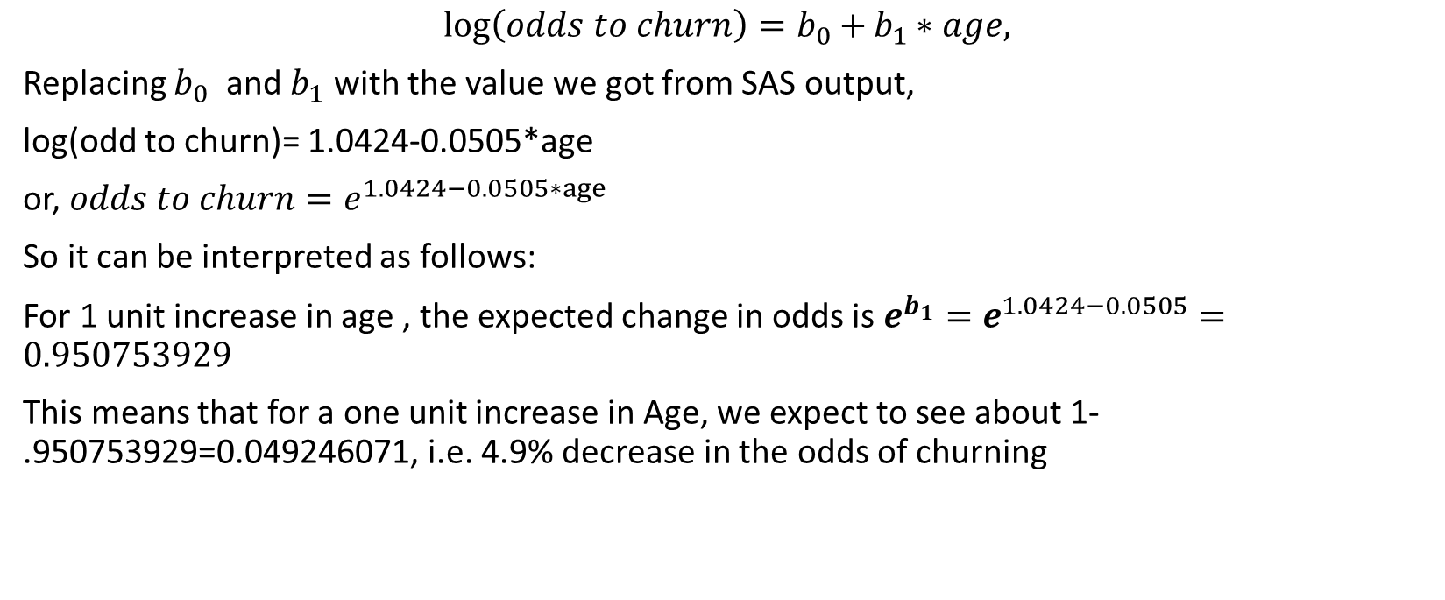
Conclusion
$$\log\left(odds to churn\right)=b_{0}+b_{1}∗age,$$
Replacing $b_{0}$ and $b_{1}$ with the value we got from SAS output,
log(odd to churn)= 1.0424-0.0505*age
or, $odds to churn=e^{1.0424−0.0505∗age}$
So it can be interpreted as follows:
For 1 unit increase in age , the expected change in odds is $e^{b_{1}}=e^{1.0424−0.0505}=0.950753929$
This means that for a one unit increase in Age, we expect to see about 1-.950753929=0.049246071, i.e. 4.9% decrease in the odds of churning

Slide 16
Limitation
I have not collected the data. So, data validation from my side has not been completed.
All other aspect of churning method have not been considered. Here we only consider the age.
Other statistical method have not been considered to prove the hypothesis

Slide 17
Recommendation
We have seen from the above conclusion , that age is the one of the significant factor for customer churning. And we have also found out that how it is affecting the churning. I would recommend that company should consider the marketing policy to attract young customers
Notes:
This data file contains telecommunications company’s effort to reduce churn in its customer base. To do that, there are multiple attributes of a customer have been addressed and taken a sample of 1000 customer to analyze the data. We have taken nine variables mainly age, year resides in the current address, income, education, churn, region, gender, marital status and customer category from a telecommunication company. These variables are mixed of continuous, discrete and categorical As described earlier, we have these variables to determine the one of the most important issue for these Telcom company that which segment of the people are more prone to start leaving the company . Here the question is that customer is churning or not, means they are disconnecting their connection or not. It is yes or no. Since the data is not continuous, we cannot choose linear regression model , rather we need to do logistic regression.
A logistic regression model is built to predict the odds corresponding to an event that has two outcomes. Logistic regression model works with one dependent variable that is a dummy variable and one or more independent variables (predictors).
As we have seen from the above conclusion , that age is the one of the significant factor for customer churning. And we have also found out that how it is affecting the churning. I would recommend that company should consider the marketing policy to attract young customers .

Slide 18
Reference:
Elliott,A ,Woodward,W. (n.d.) SAS Essentials Mastering SAS for Data Analytics Published by John Wiley & Sons, Inc., Hoboken, New Jersey Chapter 16
Park, H. (2013). An Introduction to Logistic Regression: From Basic Concepts to Interpretation with Particular Attention to Nursing Domain retrieved from https://pdfs.semanticscholar.org/3305/2b1d2363aee3ad290612109dcea0aed2a89e.pdf
Technofunc .(2019) .History of Telecommunications Industry retrieved from http://www.technofunc.com/index.php/domain-knowledge/telecom-industry/item/history-of-telecommunications-industry
Tomoiaga,A. (2019). Study note Statistics in Business Analytics , CSU Global 19WA-MIS543-1 Winter 2019

Slide 19
Thank You
Notes:
You can use this slide as your opening or closing slide. Should you choose to use it as a closing, make sure you review the main points of your presentation. One creative way to do that is by adding animations to the various graphics on a slide. This slide has 4 different graphics, and, when you view the slideshow, you will see that you can click to reveal the next graphic. Similarly, as you review the main topics in your presentation, you may want each point to show up when you are addressing that topic.
Add animation to images and graphics:
Select your image or graphic.
Click on the Animations tab.
Choose from the options. The animation for this slide is “Split”. The drop-down menu in the Animation section gives even more animations you can use.
If you have multiple graphics or images, you will see a number appear next to it that notes the order of the animations.
Note: You will want to choose the animations carefully. You do not want to make your audience dizzy from your presentation.

